Slide 1
ONLINE
VOTING SYSTEM

Slide 2
PRESENTED TO: Mohamed zeroug PRESENTED BY: Kanwarpal singh Davinder Sharma Mandeep Kaur

Slide 3
INTODUCTION
We are developing an on-line voting system by taking advantage of the centralized database with a web interface. The main concept of this project is to build a website, which should be able to allow people to cast their vote by online.
This is a simple, safe and secure method that takes minimum of time. We proceed our project with the assumption that each voter has a voter ID storing his/her unique identity including data.,

Slide 4
We are to maintain a centralized database of enrolled voters, the primary key of which is a unique VoterID stored on the database. The database administrator is the control of the website.
Many users cannot come to the voting place. Therefore we have to implement a online voting system by which the users can vote over the online

Slide 5
ONLINE VOTING SYSTEM DATABASE CONTAINS :
Voter’s Information.
Admin’s Information.
Candidates Information with Votes.
Candidates Positions.

Slide 6
The class diagram

Slide 7
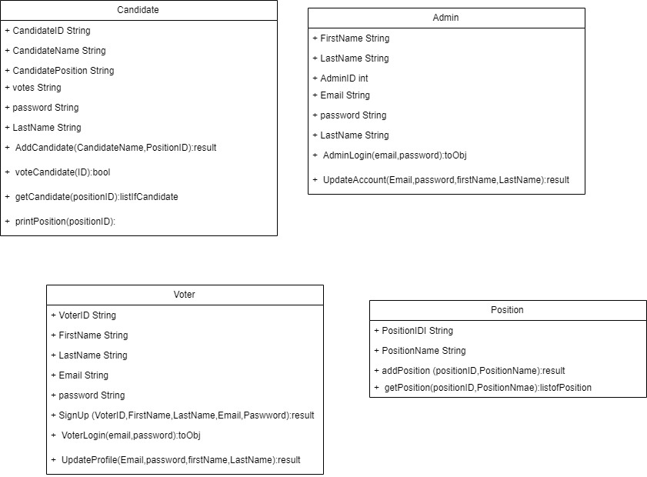

Slide 8
The database design

Slide 9
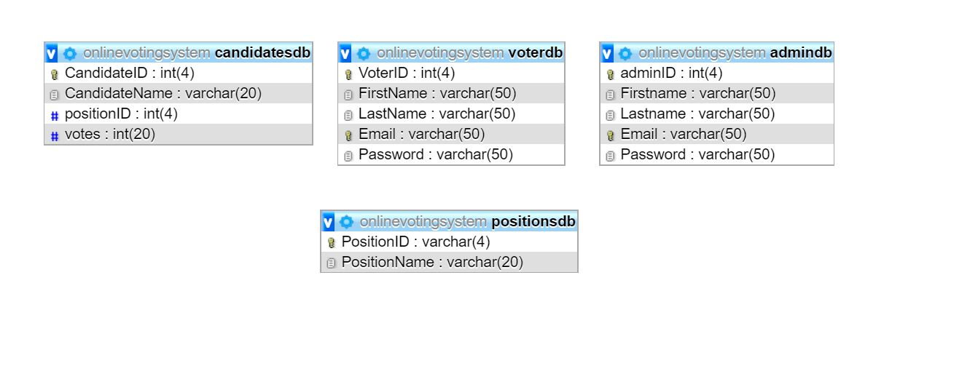

Slide 10
The Main user interfaces ADMIN: Login Manage Candidates Manage Positions Check Poll Results Update Profile Logout

Slide 11
USER: Registration Login Update Profile Choose Positions for Voting Logout

Slide 12
PROJECT EXTENSION

Slide 13
Improvement in Design Addition of more Features Can be more Secure

Slide 14
THANK YOU

